Slide 1
Spring Boot
Mentor : Rahul Dixit

Slide 2
Getting Started with Spring Boot
WHY Spring Boot?
You can build web apps & REST API WITHOUT Spring Boot
Then What is the need for Spring Boot?
WHAT are the goals of Spring Boot?
HOW does Spring Boot work?
COMPARE Spring Boot vs Spring MVC vs Spring

Slide 3
Getting Started with Spring Boot - Approach
1. Understand the world before Spring Boot.
2: Create a Spring Boot Project.
3: Build a simple REST API using Spring Boot.
4: Understand the MAGIC of Spring Boot.
Spring Initializr
Starter Projects
Auto Configuration
Developer Tools
Actuator ...

Slide 4
World Before Spring Boot!
Setting up Spring Projects before Spring Boot was NOT easy!
We needed to configure a lot of things before we have a production-ready application

Slide 5
Dependency Management
Dependencies refer to external libraries or modules that an application requires to function correctly.
Dependency management is the process of handling and organizing these external libraries or modules.
It ensures that the application has the necessary dependencies and versions to function correctly.
In Spring Boot, dependency management is handled by build tools like
Maven
Gradle.s

Slide 6
Maven Dependency
Maven is a popular build tool for managing dependencies in Spring Boot applications.
Maven uses an XML file called the "pom.xml" to configure and manage dependencies.
<dependency>
<groupId>org.springframework.boot</groupId>
<artifactId>spring-boot-starter-web</artifactId>
</dependency>

Slide 7
Dependency Scopes
Scope determines where the dependency is available in the project.
Compile: This scope is the default scope. The dependency is available in all Proprietary content. All rights reserved. Unauthorized use or distribution prohibited. phases of the project.
Provided: The dependency is provided by the container (e.g., Tomcat) during runtime, and it is not included in the packaged application.
Runtime: The dependency is required during runtime, but it is not required for compilation.
Test: The dependency is only required for testing purposes and is not included in the packaged application.

Slide 8
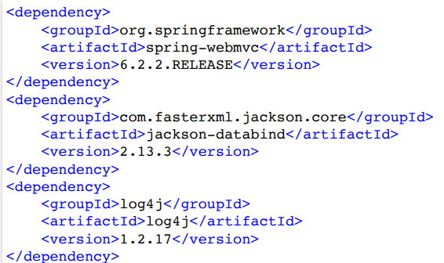
World Before Spring Boot - 1 - Dependency Management
Manage frameworks and versions
REST API - Spring framework, Spring MVC framework, JSON binding framework, ..
Unit Tests - Spring Test, Mockito, JUnit, ...

Slide 9
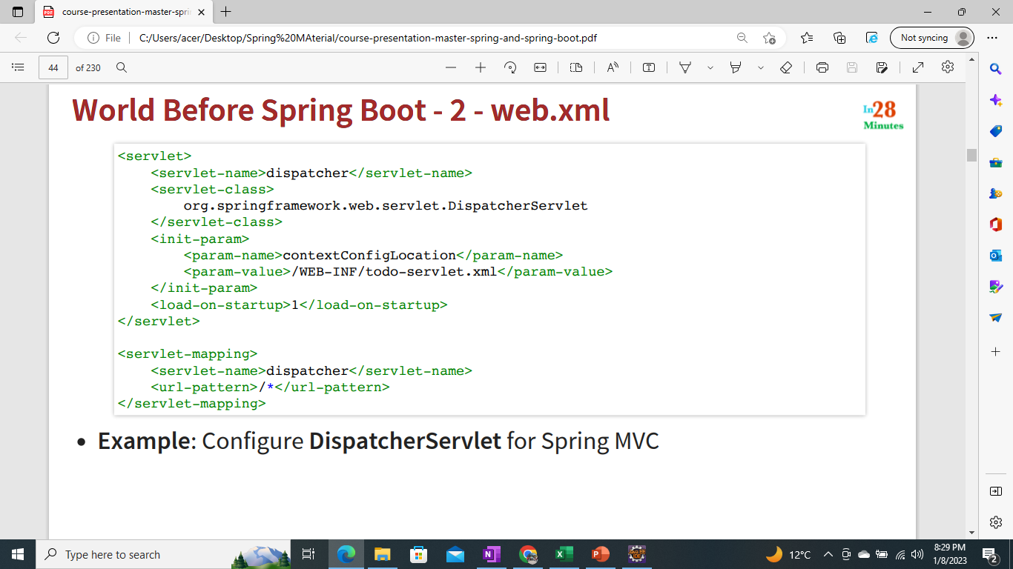
World Before Spring Boot - 2 - web.xml

Slide 10
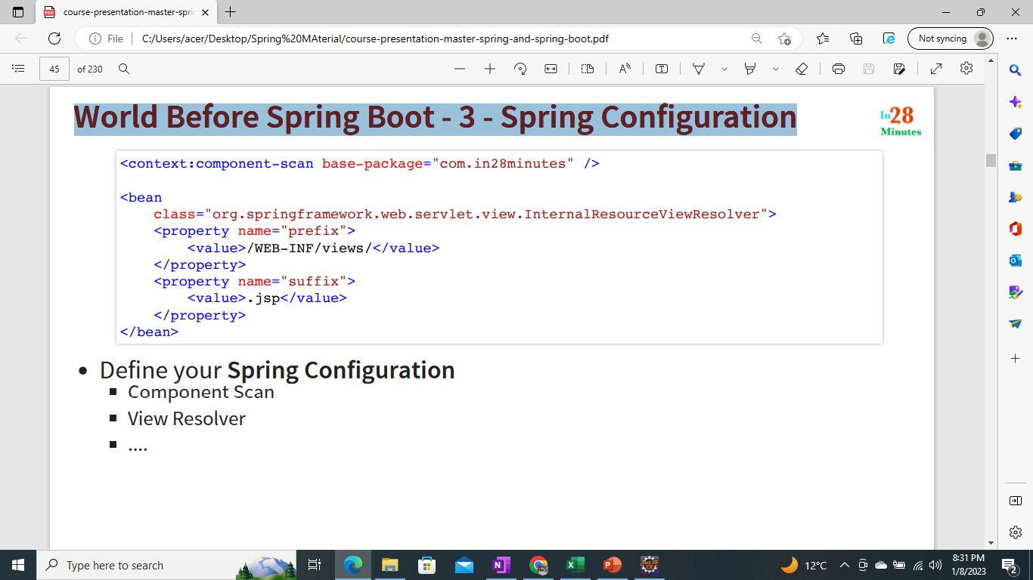
World Before Spring Boot - 3 - Spring Configuration
Define your Spring Configuration
Component Scan
View Resolver ....

Slide 11
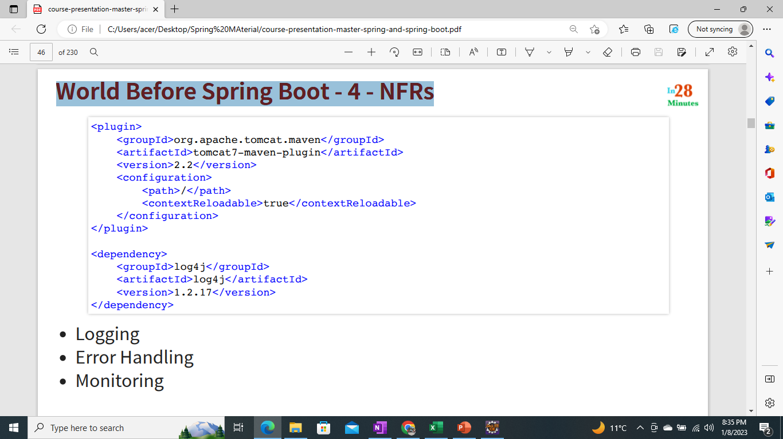
World Before Spring Boot - 4 - NFRs
Logging
Error Handling
Monitoring

Slide 12
World Before Spring Boot!
Setting up Spring Projects before Spring Boot was NOT easy!
1: Dependency Management (pom.xml)
2: Define Web App Configuration (web.xml)
3: Manage Spring Beans (context.xml)
4: Implement Non-Functional Requirements (NFRs)
AND repeat this for every new project!
Typically takes a few days to setup for each project (and countless hours to maintain)

Slide 13
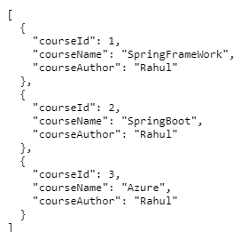
Understanding Power of Spring Boot
1: Create a Spring Boot Project
2: Build a simple REST API using Spring Boot

Slide 14
What's the Most Important Goal of Spring Boot?
Help you build PRODUCTION-READY apps QUICKLY
Build QUICKLY
Spring Initializr
Spring Boot Starter Projects
Spring Boot Auto Configuration
Spring Boot DevTools
Be PRODUCTION-READY
Logging
Different Configuration for Different Environments
Profiles, ConfigurationProperties
Monitoring (Spring Boot Actuator) ...

Slide 15
Exploring Spring Boot Starter Projects
I need a lot of frameworks to build application features:
Build a REST API: I need Spring, Spring MVC, Tomcat, JSON conversion...
Write Unit Tests: I need Spring Test, JUnit, Mockito, ...
How can I group them and make it easy to build applications?
Starters: Convenient dependency descriptors for diff. features
Spring Boot provides variety of starter projects:
Web Application & REST API - Spring Boot Starter Web (spring-webmvc, springweb, spring-boot-starter-tomcat, spring-boot-starter-json)
Unit Tests - Spring Boot Starter Test
Talk to database using JPA - Spring Boot Starter Data JPA
Talk to database using JDBC - Spring Boot Starter JDBC
Secure your web application or REST API - Spring Boot Starter Security
(REMEMBER) Starters: Define all application dependencies

Slide 16
Exploring Spring Boot Auto Configuration
I need lot of configuration to build Spring app:
Component Scan, DispatcherServlet, Data Sources, JSON Conversion, ...
How can I simplify this?
Auto Configuration: Automated configuration for your app
Decided based on:
Which frameworks are in the Class Path?
What is the existing configuration (Annotations etc)?
Example: Spring Boot Starter Web
Dispatcher Servlet (DispatcherServletAutoConfiguration)
Embedded Servlet Container - Tomcat is the default (EmbeddedWebServerFactoryCustomizerAutoConfiguration)
Default Error Pages (ErrorMvcAutoConfiguration)
Bean<->JSON (JacksonHttpMessageConvertersConfiguration)

Slide 17
Understanding the Glue - @SpringBootApplication
Questions:
Who is launching the Spring Context?
Who is triggering the component scan?
Who is enabling auto configuration?
Answer: @SpringBootApplication
1: @SpringBootConfiguration: Indicates that a class provides Spring Boot application @Configuration.
2: @EnableAutoConfiguration: Enable auto-configuration of the Spring Application Context,
3: @ComponentScan: Enable component scan (for current package, by default)

Slide 18
Build Faster with Spring Boot DevTools
Add Dependency DevTools In pom.xml
<dependency>
<groupId>org.springframework.boot</groupId>
<artifactId>spring-boot-devtools</artifactId>
</dependency>
Increase developer productivity
Why do you need to restart the server manually for every code change?
Remember: For pom.xml dependency changes, you will need to restart server manually
Not able to handle change in pom.xml

Slide 19
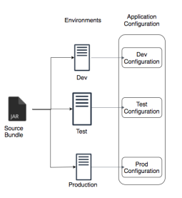
Managing App. Configuration using Profiles
Applications have different environments: Dev, QA,
Stage, Prod, ...
Different environments need different configuration:
Different Databases
Different Web Services
How can you provide different configuration for
different environments?
Profiles: Environment specific configuration
How can you define externalized configuration for your application?
ConfigurationProperites: Define externalized configuration
(Create Separate Profile and Configuration w.r.t to Environment )

Slide 20
i.e. dev : - trace level profile
(application-dev.properties)->logging.level.org.springframework=debug
i.e prod :- info level profile
(application-prod.properties)->logging.level.org.springframework=info
Trace - Everything
debug – more than info
Info – all things which are logged @info level
Warning – little more than error
Error – only error
Off – off the log
(How to create profile go to Example com.rahul.boot.SpringWithRest CurrencyServiceConfiguration )

Slide 21
Monitor Applications using Spring Boot Actuator
Monitor and manage your application in your production
Provides a number of endpoints:
beans - Complete list of Spring beans in your app
health - Application health information
metrics – Application metrics
mappings - Details around Request Mappings

Slide 22
Beans-"http://localhost:8080/actuator/beans"
caches-cache
-http://localhost:8080/actuator/caches/{cache}
Caches-
http://localhost:8080/actuator/caches
Health-
http://localhost:8080/actuator/health
health-path
-http://localhost:8080/actuator/health/{*path}
Info-http://localhost:8080/actuator/info
Conditions-http://localhost:8080/actuator/conditions
Configprops-http://localhost:8080/actuator/configprops
configprops-prefix-http://localhost:8080/actuator/configprops/{prefix}
Env-http://localhost:8080/actuator/env
env-toMatch
-http://localhost:8080/actuator/env/{toMatch}
Loggers-http://localhost:8080/actuator/loggers
loggers-name
-"http://localhost:8080/actuator/loggers/{name}"
Heapdump-
"http://localhost:8080/actuator/heapdump"
Threaddump
-"http://localhost:8080/actuator/threaddump"
metrics-requiredMetricName
-http://localhost:8080/actuator/metrics/{requiredMetricName}
Metrics-
http://localhost:8080/actuator/metrics
Scheduledtasks
-http://localhost:8080/actuator/scheduledtasks
Mappings
-"http://localhost:8080/actuator/mappings"

Slide 23
Understanding Spring Boot vs Spring MVC vs Spring
Spring Boot vs Spring MVC vs Spring: What's in it?
Spring Framework: Dependency Injection
@Component, @Autowired, Component Scan etc..
Just Dependency Injection is NOT sufficient (You need other frameworks to build apps)
Spring Modules and Spring Projects: Extend Spring Eco System
Provide good integration with other frameworks (Hibernate/JPA, JUnit & Mockito for Unit Testing)
Spring MVC (Spring Module): Simplify building web apps and REST API
Building web applications with Struts was very complex
@Controller, @RestController, @RequestMapping("/courses")
Spring Boot (Spring Project): Build PRODUCTION-READY apps QUICKLY
Starter Projects - Make it easy to build variety of applications
Auto configuration - Eliminate configuration to setup Spring, Spring MVC and other frameworks!
Enable non functional requirements (NFRs):
Actuator: Enables Advanced Monitoring of applications
Embedded Server: No need for separate application servers!
Logging and Error Handling
Profiles and ConfigurationProperties

Slide 24
doubts

Slide 25
JPA and Hibernate

Slide 26
Approach
Create a Spring Boot Project with H2
Create COURSE table
Use Spring JDBC to play with COURSE table
Use JPA and Hibernate to play with COURSE table
Use Spring Data JPA to play with COURSE table

Slide 27
Spring Boot Auto Configuration
We added Data JPA and H2 dependencies:
Spring Boot Auto Configuration does some magic:
Initialize JPA and Spring Data JPA frameworks
Launch an in memory database (H2)
Setup connection from App to in-memory database
Launch a few scripts at startup (example: data.sql, schema.sql)
Remember - H2 is in memory database
Does NOT persist data
Great for learning
BUT NOT so great for production

Slide 28
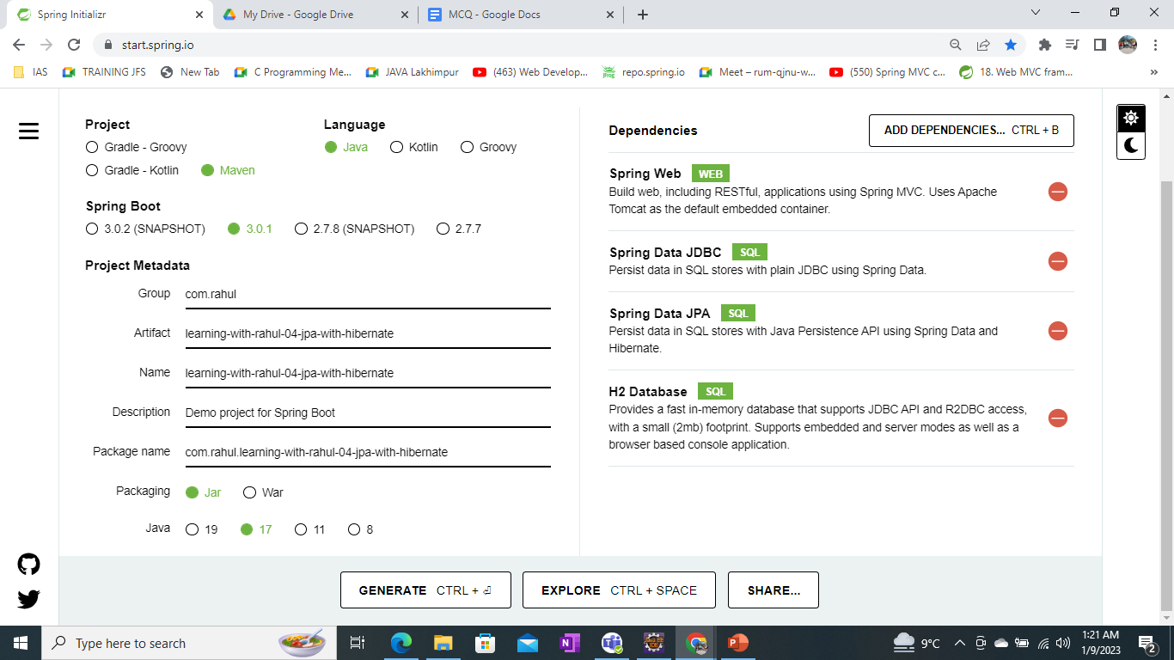
Boot + JPA + Hibernate

Slide 29
JDBC to Spring JDBC to JPA to Spring Data JPA
JDBC
Write a lot of SQL queries! (delete from todo where id=?)
And write a lot of Java code
Spring JDBC (E.g :- learning-with-rahul-04-jdbcTemplate-with-hibernate)
Write a lot of SQL queries (delete from todo where id=?)
BUT lesser Java code
JPA (E.g.learning-with-rahul-04-jpa-with-hibernate)
Do NOT worry about queries
Just Map Entities to Tables!
Spring Data JPA (E.g. learning-with-rahul-04-springdatajpa-with-hibernate)
Let's make JPA even more simple!
I will take care of everything!

Slide 30
JDBC to Spring JDBC
JDBC example:
public void deleteTodo(int id) {
PreparedStatement st = null;
try {
st = db.conn.prepareStatement("delete from todo where id=?");
st.setInt(1, id);
st.execute();
} catch (SQLException e) {
logger.fatal("Query Failed : ", e);
} finally {
if (st != null) {
try {st.close();}
catch (SQLException e) {}}}}

Slide 31
Spring JDBC example
public void deleteTodo(int id) {
jdbcTemplate.update("delete from todo where id=?", id);
}

Slide 32
JPA Example
@Repository
public class PersonJpaRepository {
@PersistenceContext
EntityManager entityManager;
public Person findById(int id) {
return entityManager.find(Person.class, id);}
public Person update(Person person) {
return entityManager.merge(person);}
public Person insert(Person person) {
return entityManager.merge(person);}
public void deleteById(int id) {........

Slide 33
Spring Data JPA Example
public interface TodoRepository extends JpaRepository{}

Slide 34
Hibernate vs JPA
JPA defines the specification. It is an API.
How do you define entities?
How do you map attributes?
Who manages the entities?
Hibernate is one of the popular implementations of JPA
Using Hibernate directly would result in a lock in to Hibernate
There are other JPA implementations (Toplink, for example)

Slide 35
Thanks

